Slide 1
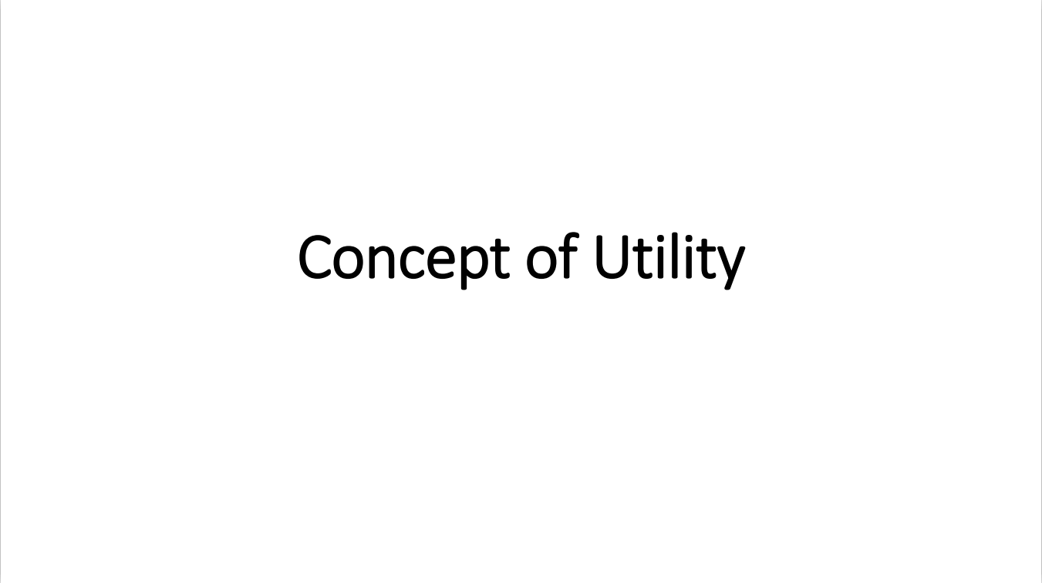

Slide 2
What we will discuss here?
Meaning and definition of utility.
Cardinal Utility
Ordinal Utility
Law of diminishing marginal utility
Equi-marginal utility

Slide 3
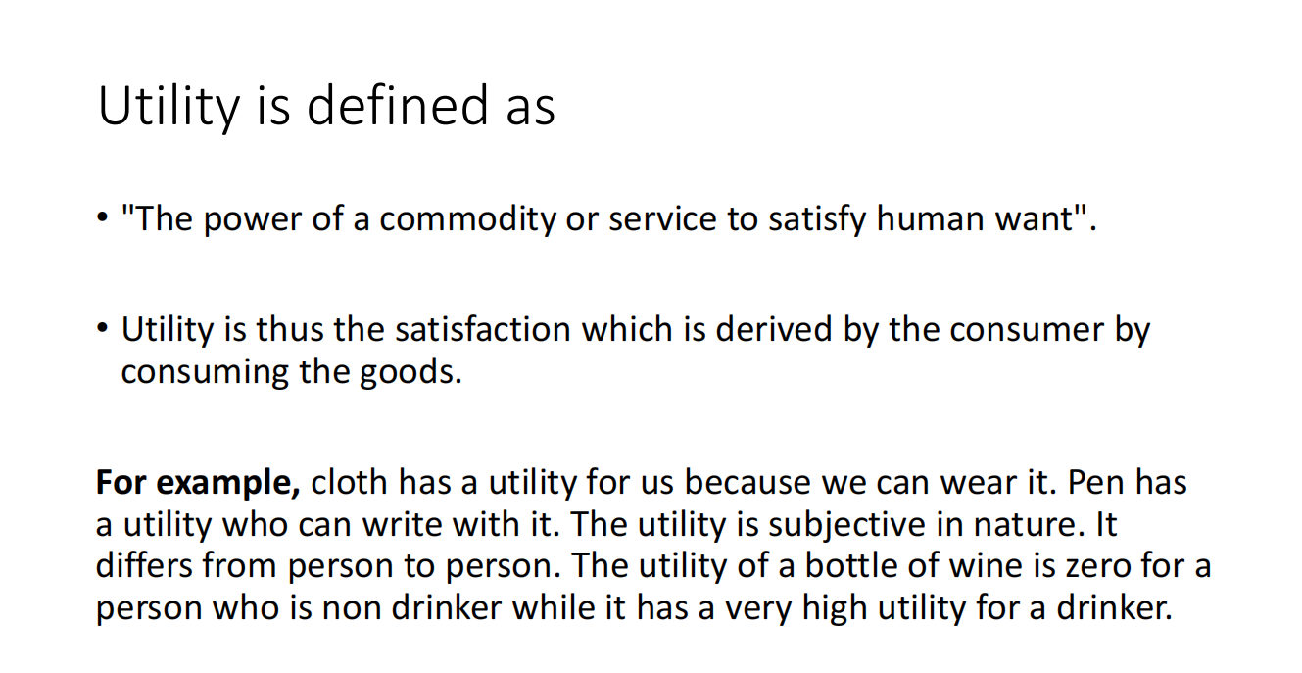

Slide 4
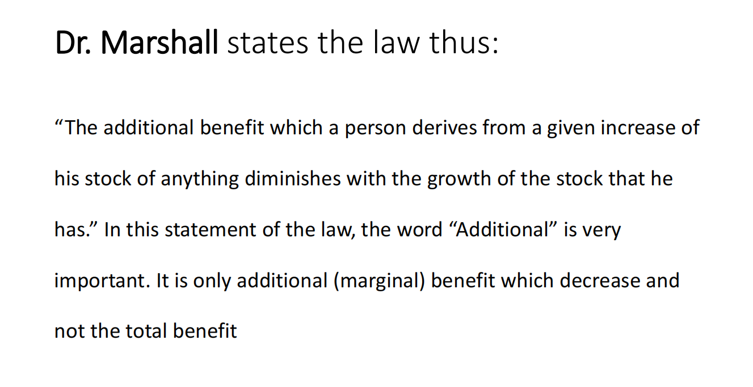

Slide 5
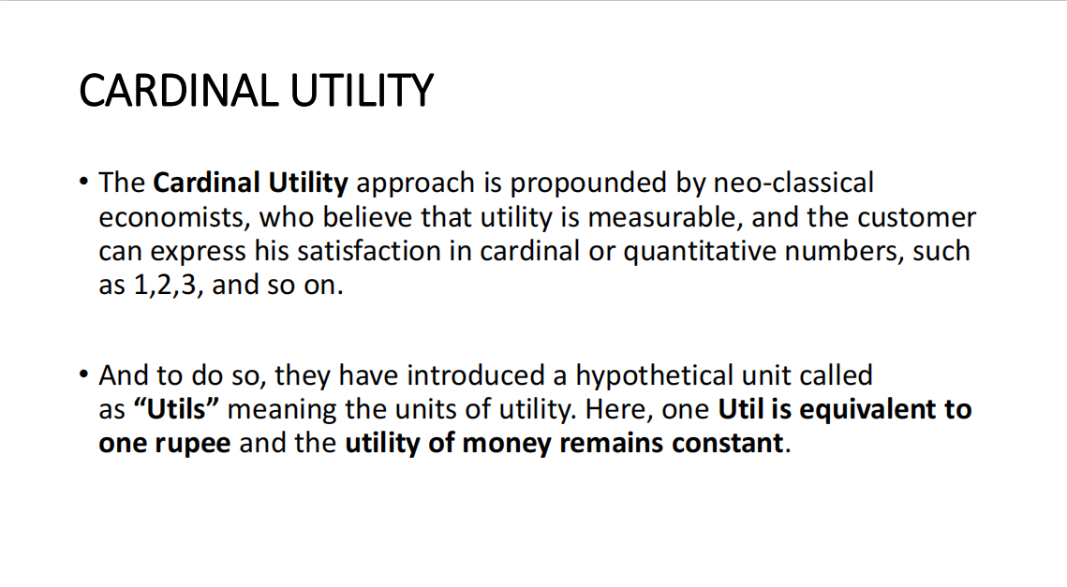

Slide 6
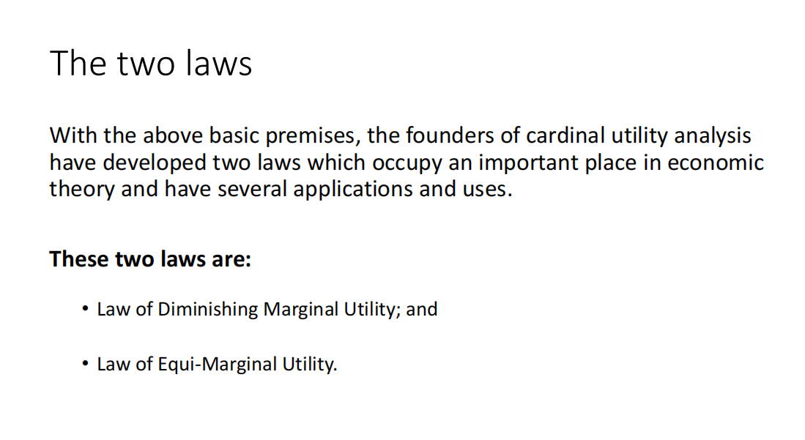

Slide 7
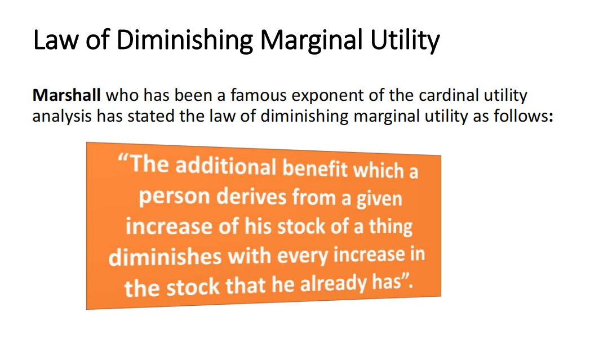

Slide 8
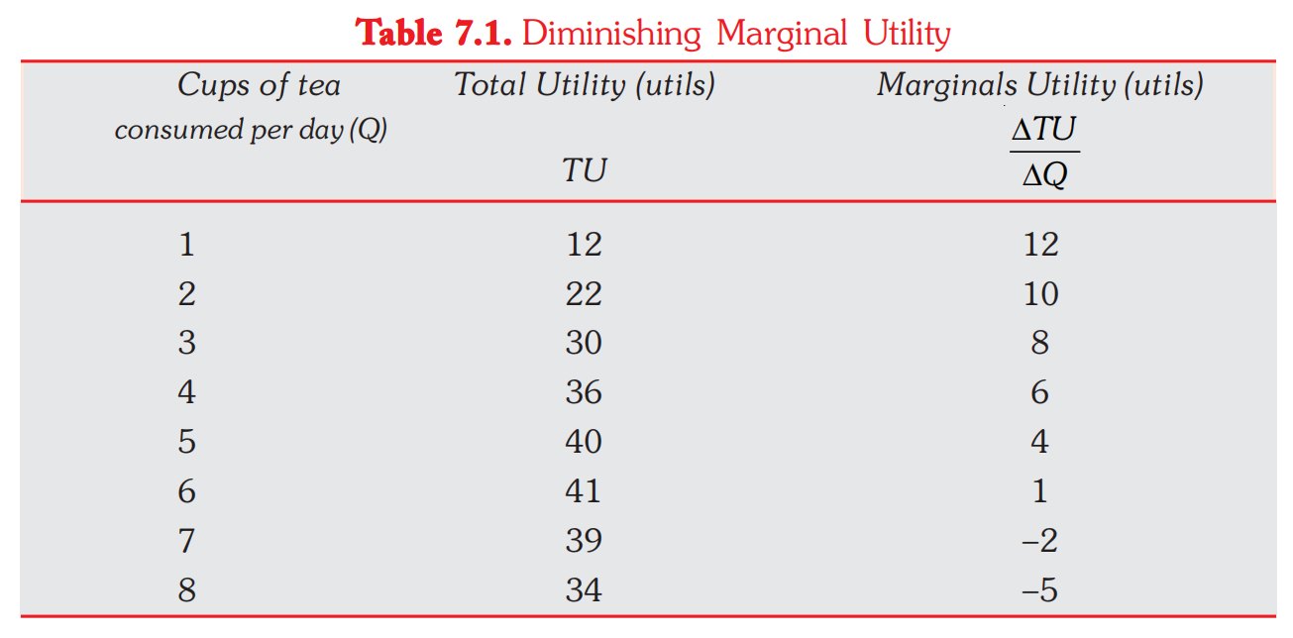

Slide 9
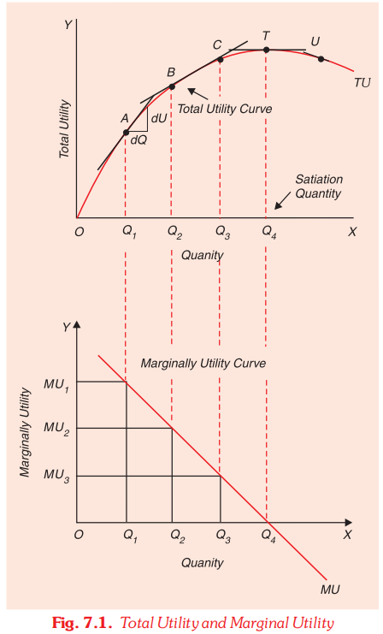

Slide 10
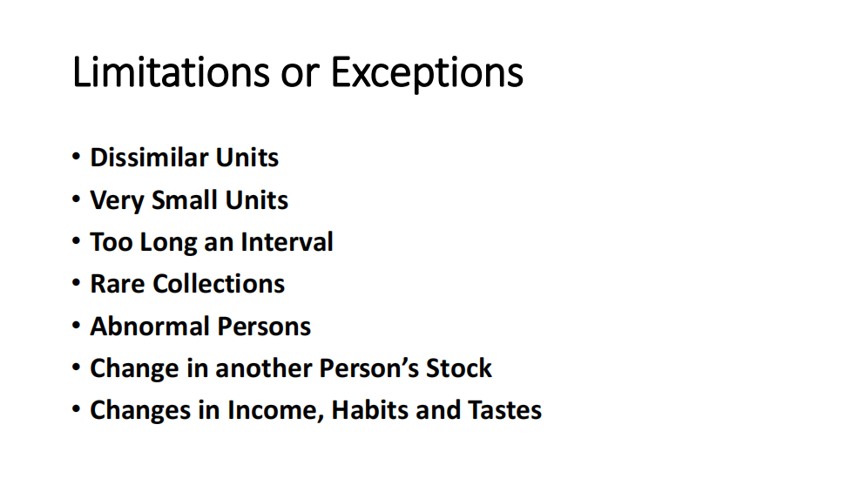

Slide 11
CONSUMER’S EQUILIBRIUM: PRINCIPLE OF EQUI-MARGINAL UTILITY
Principle of equi-marginal utility occupies an important place in cardinal utility analysis.
A consumer has a given income which he has to spend on various goods he wants.
Now, the question is how he would allocate his given money income among various goods, that is to say, what would be his equilibrium position in respect of the purchases of the various goods.

Slide 12
Cont…
Suppose there are only two goods X and Y on which a consumer has to spend a given income. The consumer’s behaviour will be governed by two factors: first, the marginal utilities of the goods and secondly, the prices of two goods.
Suppose the prices of the goods are given for the consumer.

Slide 13
Law of equi-marginal utility
The law of equi-marginal utility states that the consumer will distribute his money income between the goods in such a way that the utility derived from the last rupee spent on each good is equal.
In other words, consumer is in equilibrium position when marginal utility of money expenditure on each good is the same.

Slide 14
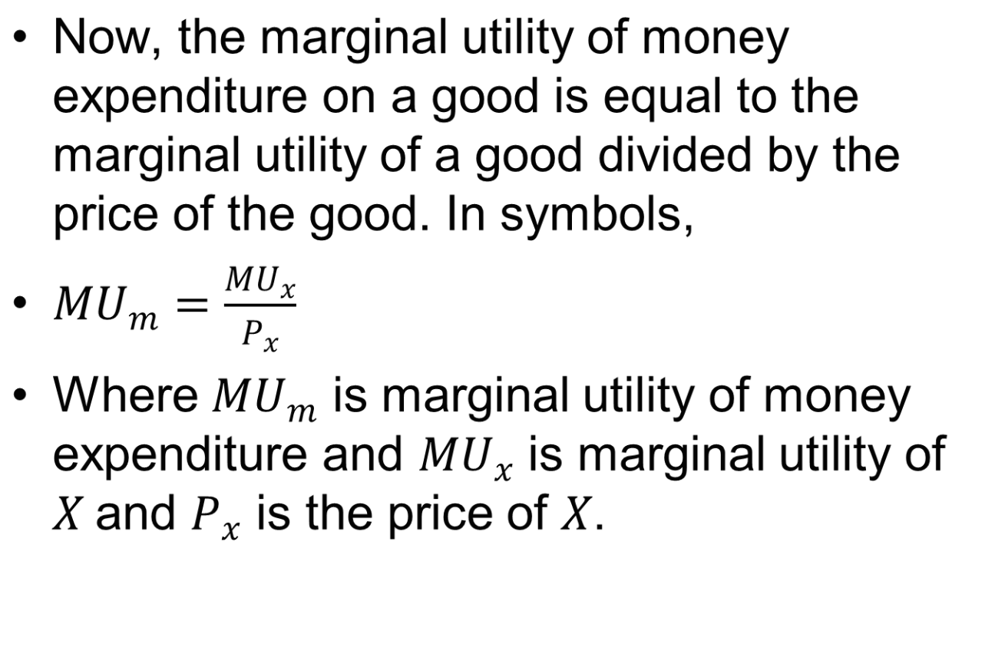

Slide 15
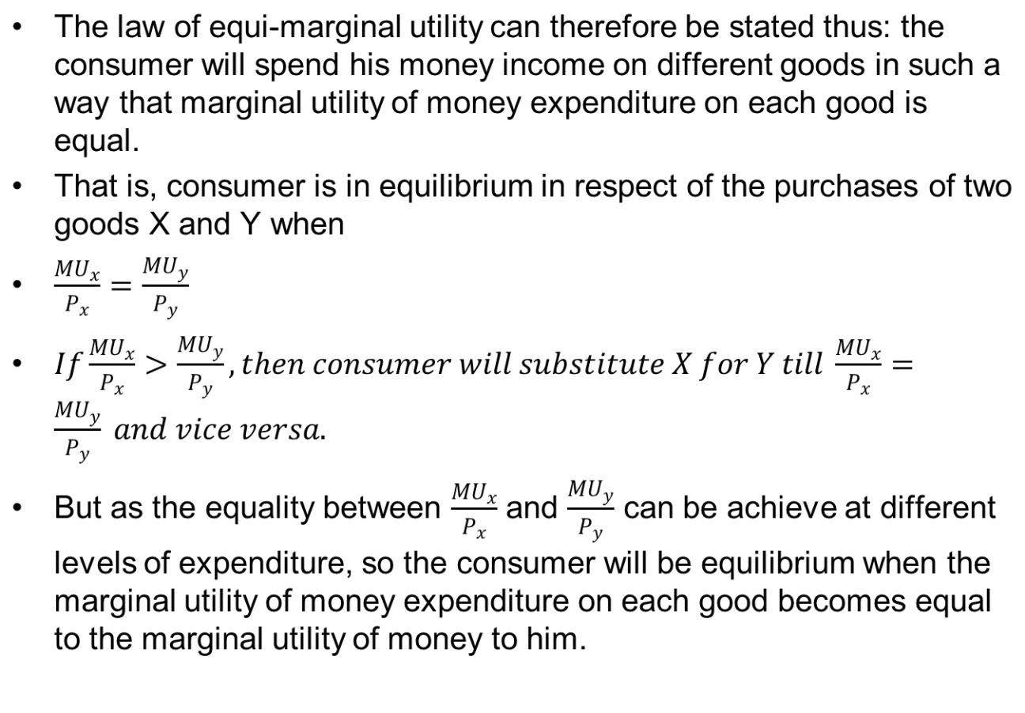

Slide 16
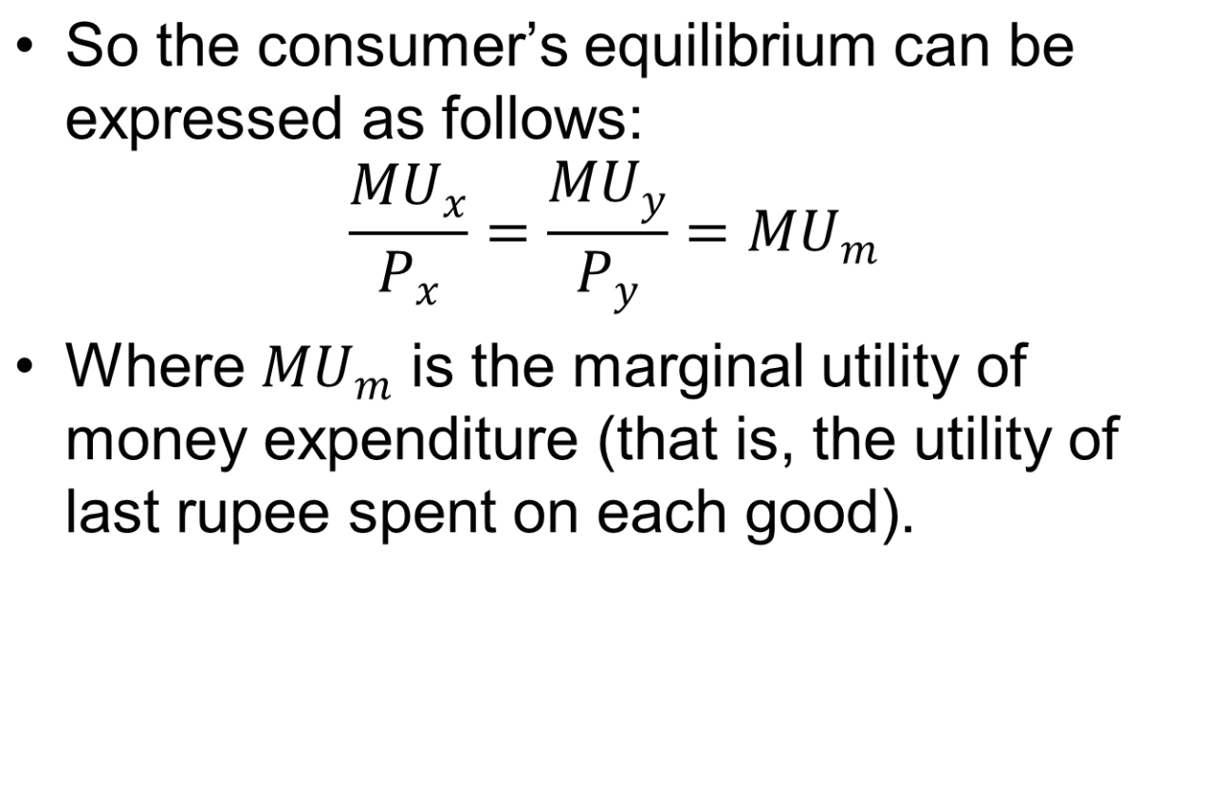

Slide 17
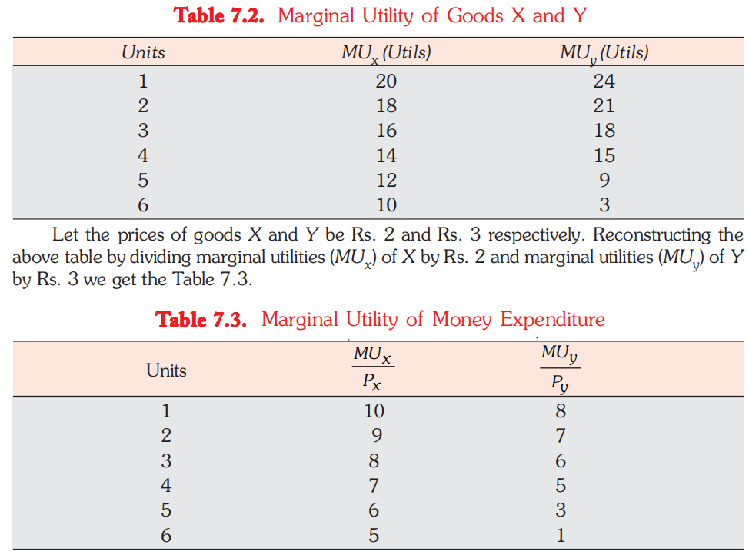











































Income= Rs. 24

Slide 18
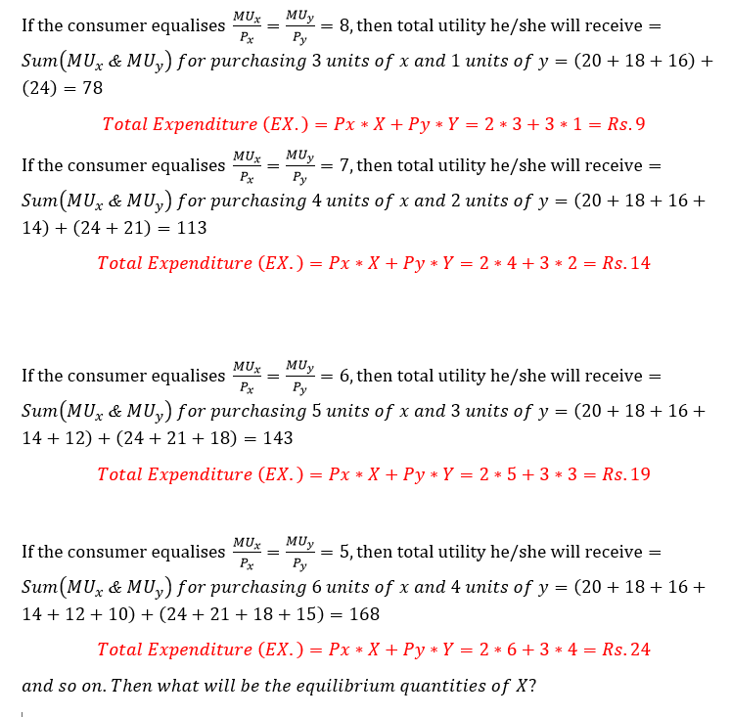















Slide 19
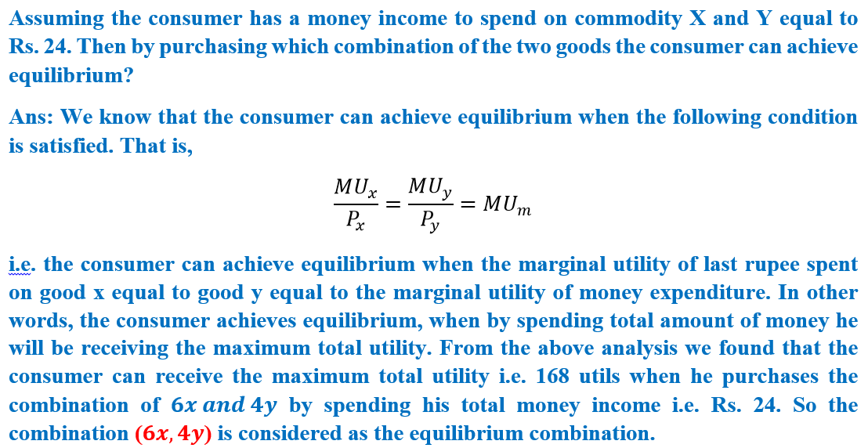


Slide 20
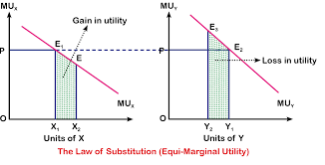
Y

Slide 21


Slide 22
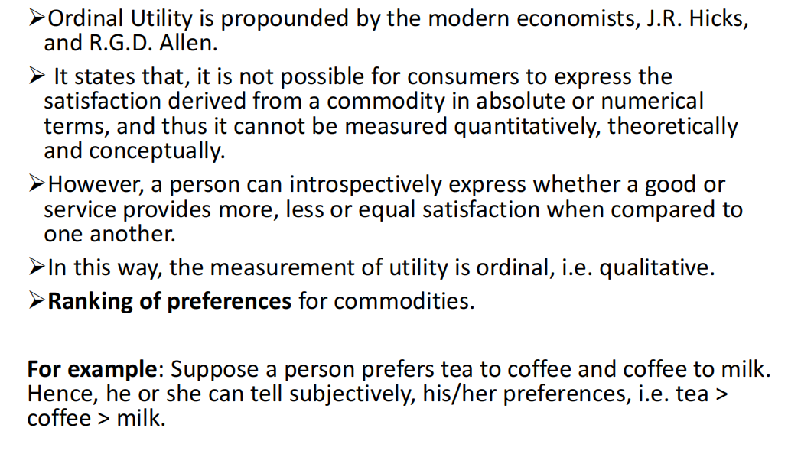

Slide 23
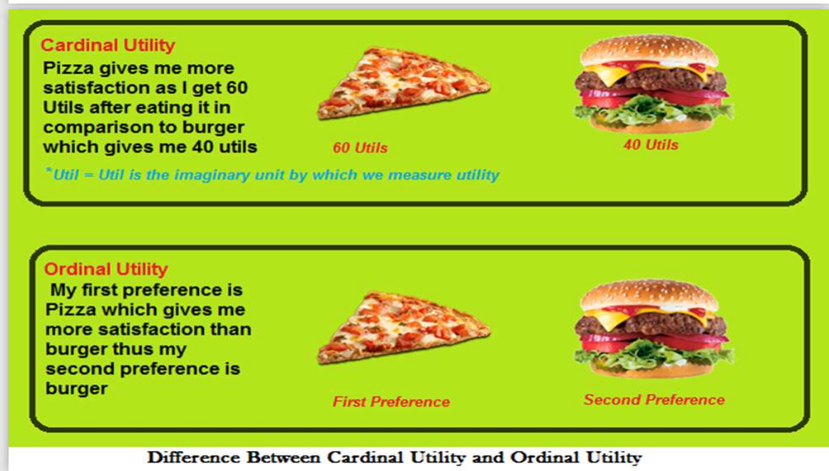

Slide 24
Thank You...

